Slide 1

Aviation Accident Analysis
Understanding accidents trends

Slide 2
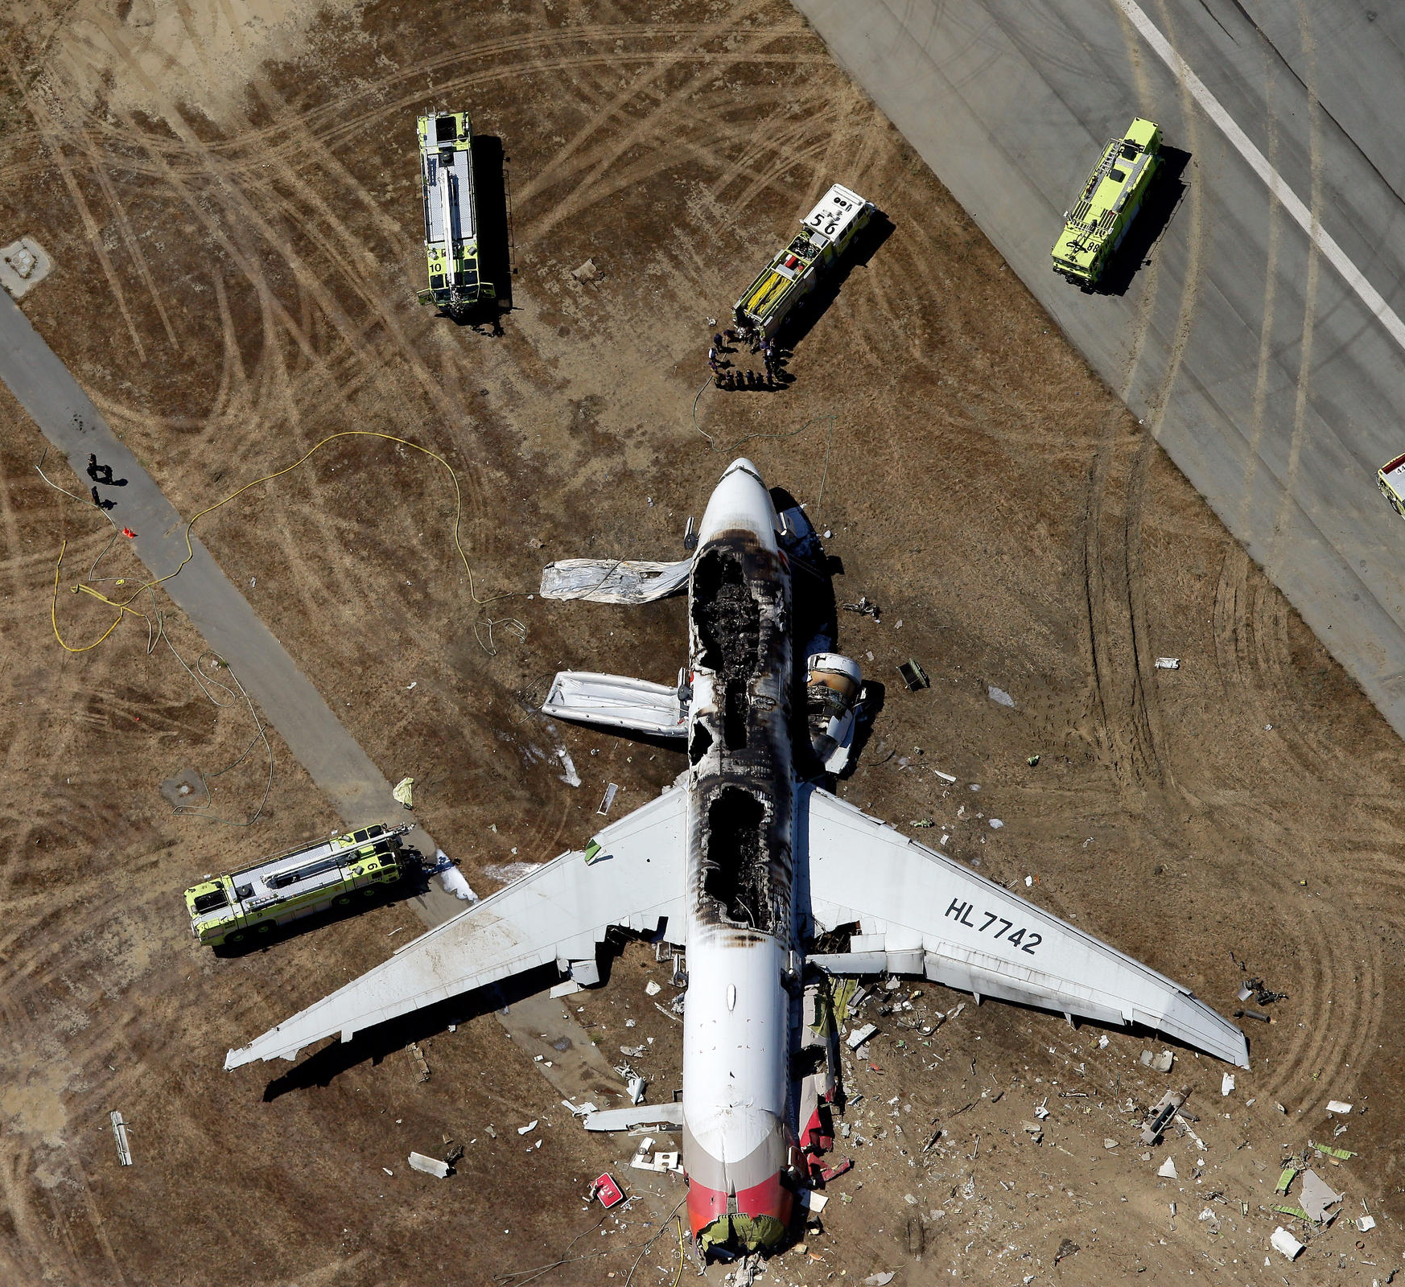
Introduction
Air travel is considered one of the safest modes of transportation, yet accidents still occur.
This project aims to analyze aviation accident data to identify trends in the US in different states among different plane makes and models

Slide 3
Project Objectives
Explore aviation accident trends over time.
Identify key factors influencing accident severity.
Visualize patterns in accident occurrences.
Provide insights for improved aviation safety.

Slide 4
Dataset
The data set comprises of over 80,000 investigated aviation accidents and incidents starting form the 1940’s
The data is mainly centered around events that happened in the US in different states
Key features of the data set include:
Accident date & location
Injuries (Fatal, Serious, Minor, Uninjured)
Aircraft details (Type, Number of Engines)

Slide 5

Data Cleaning & Preprocessing
Removed missing values and inconsistencies.
Standardized column names for uniformity.
Converted necessary data types (e.g., Date format).
Removed duplicates in the Data Frame.
Created new feature in the data set(e.g state column) by merging it with the US_State csv file

Slide 6
Trends Over Time
Number of aviation accidents has fluctuated over the years.
Recent trends indicate improved safety measures.

Slide 7
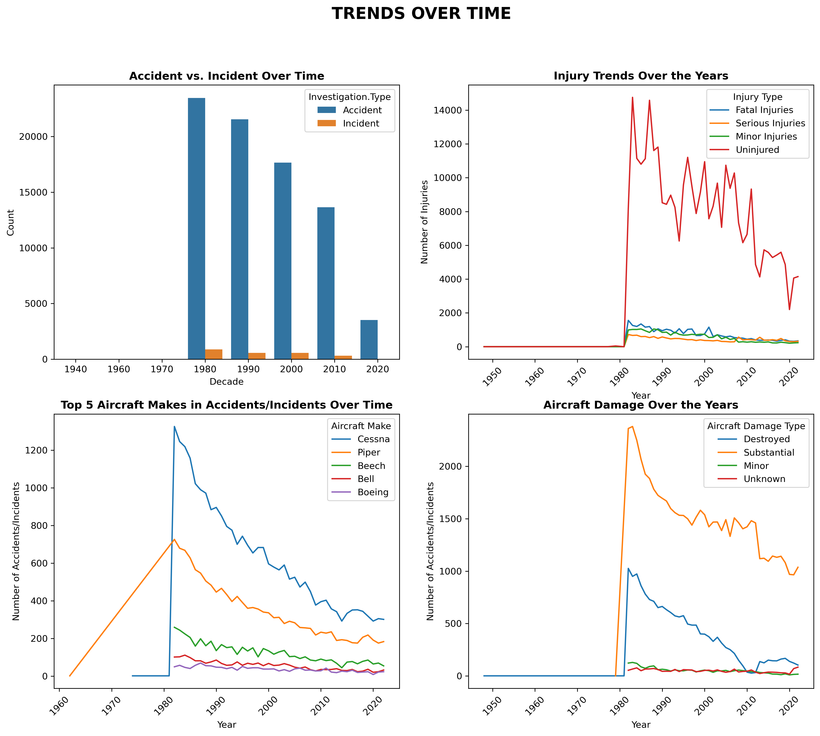
Trends Over Time

Slide 8
Correlation Analysis
A correlation matrix was used to identify relationships between different variables.
Key Observations:
Fatal injuries correlate with serious injuries.
Number of engines has a weak correlation with injuries

Slide 9
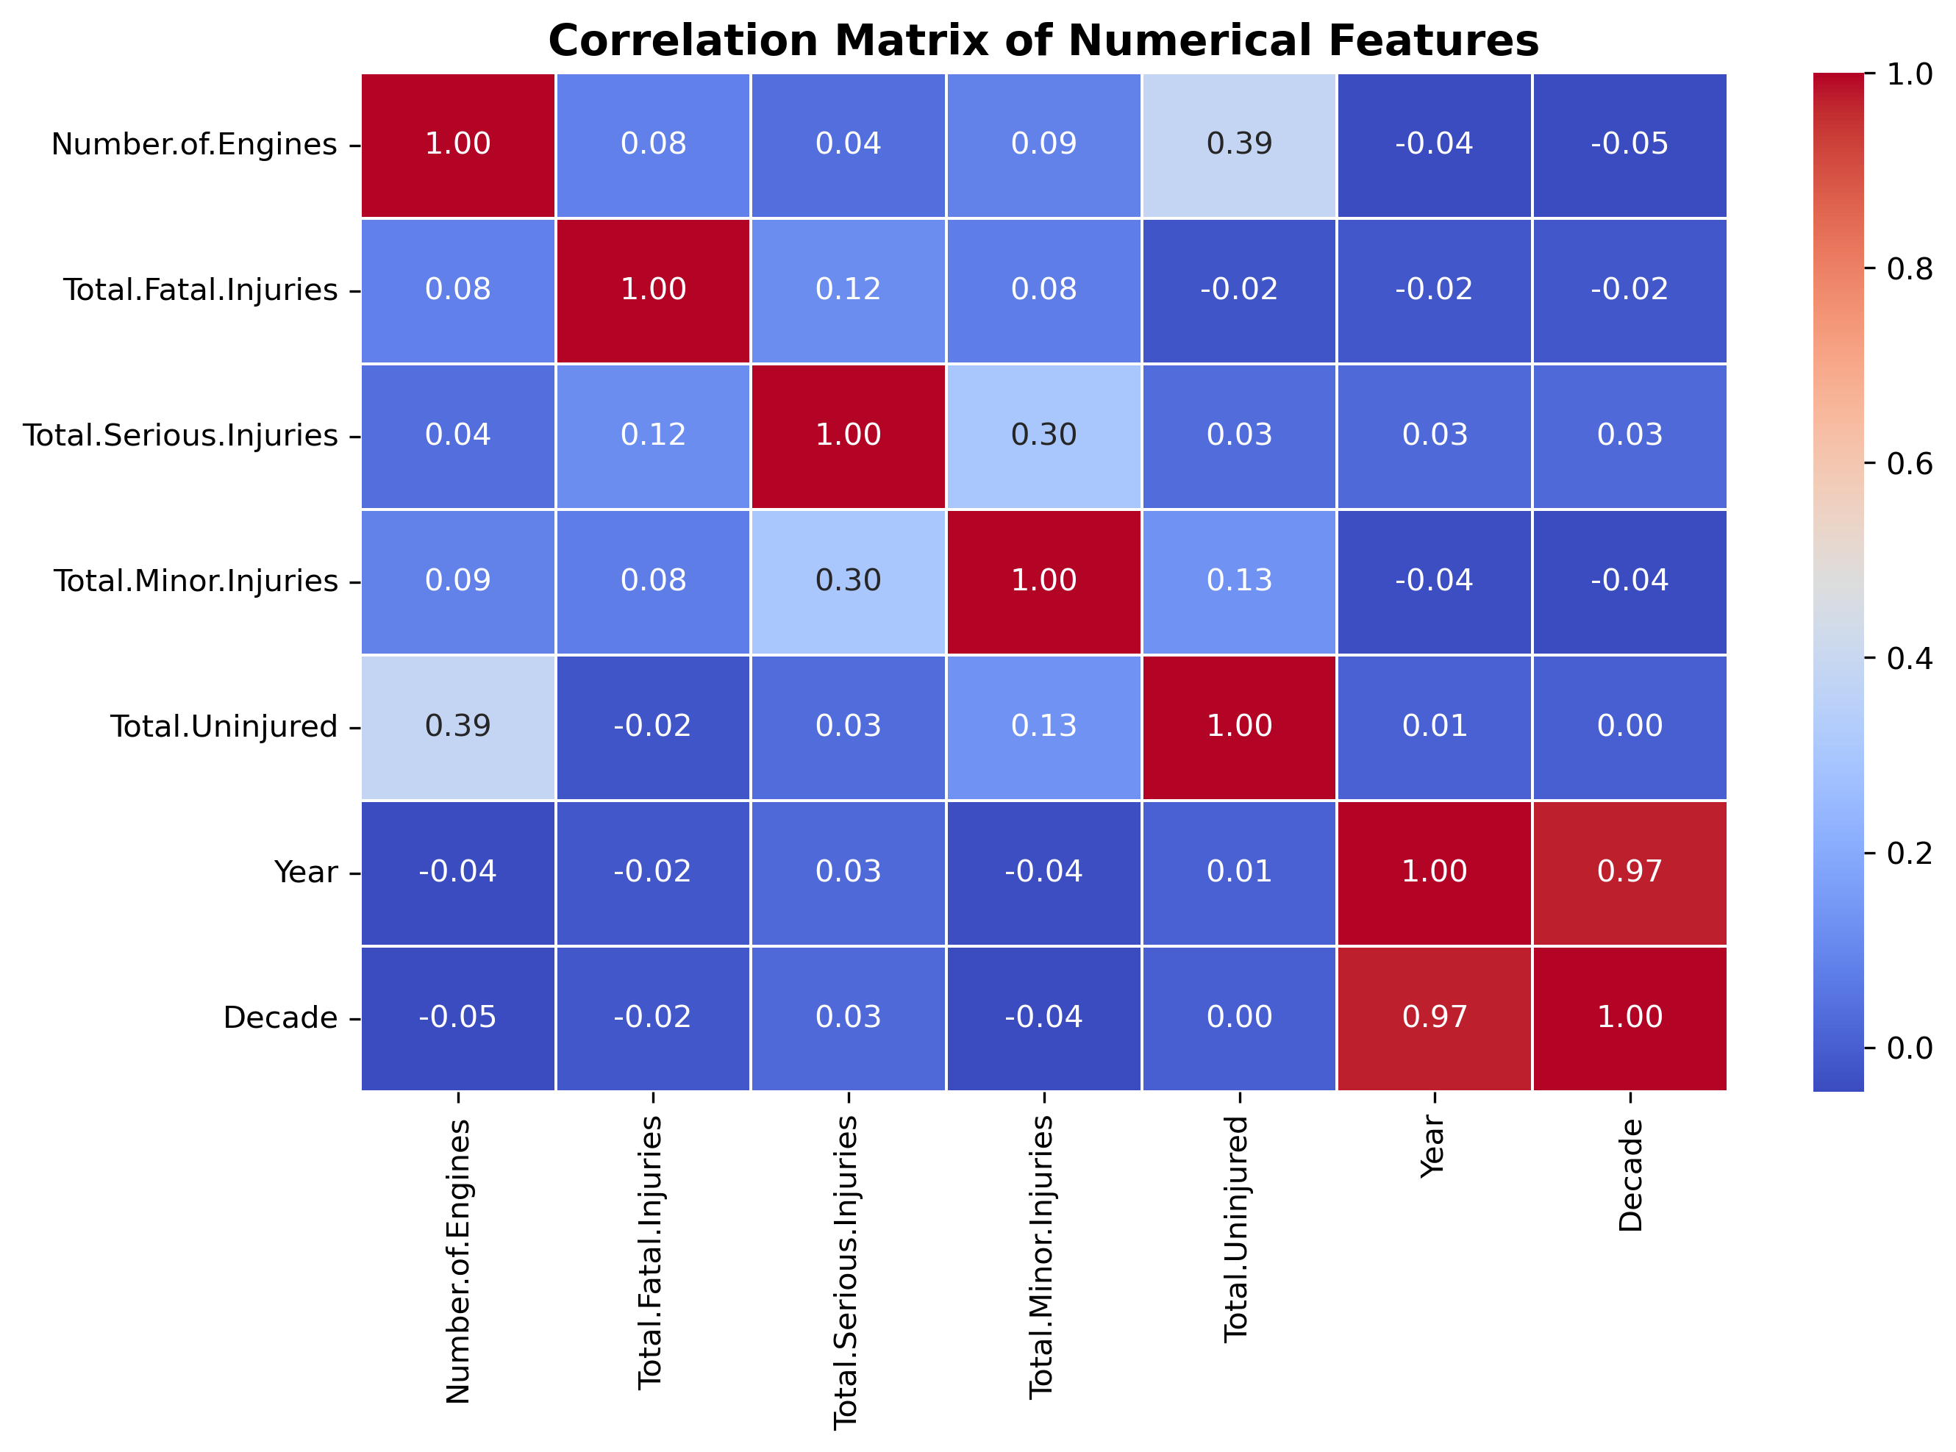
Correlation Analysis

Slide 10
Key Takeaways
Most accidents result in minor or no injuries.
Serious and fatal injuries tend to occur together.
Over the years, aviation safety has improved.(Most likely due to Technological advancements over the years)

Slide 11
Key Takeaways
Most accidents result in minor or no injuries.
Serious and fatal injuries tend to occur together.
Over the years, aviation safety has improved.(Most likely due to Technological advancements over the years)

Slide 12



Recommendations
Conclusion
Improve Aircraft Safety Measures (e.g., better emergency protocols).
Enhance Pilot Training to handle critical situations.
Increase Awareness of contributing factors to accidents.
Data analysis helps us understand aviation safety trends.
Findings can be used for better preventive measures.
Future studies can incorporate additional factors such as weather conditions

Slide 13

Thank you
anthony.chege@student.moringaschool.com
TonnieD

